Slide 1


Magnetic Shape Memory Alloy Composite Research
Mikela Petersen
NASA Space Grant Consortium, University of Arizona
22 April 2022 – 23 April 2022

Slide 2
Project Objective
Develop a magnetically activated composite (MAC) consisting of:
  Ni-Mn-Ga Magnetic Shape Memory Alloy (MSMA)
  Polymer
  Iron particles
The MAC will be used to make highly compliant
  Actuators
  Sensors
  Dampers
for nano and micro precision applications.
Notes:
the MAC should preserve the MSMA’s operating frequencies while improving the compliance of the material

Slide 3
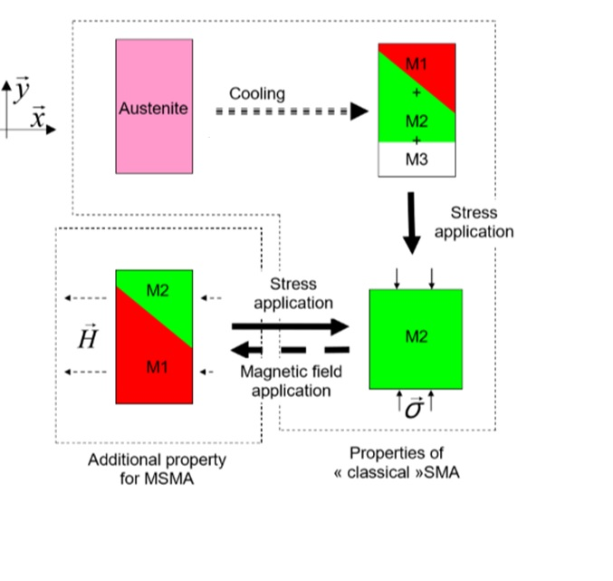
Magnetic Shape Memory Alloys (MSMA)
Specifically used the Ni-Mn-Ga alloy
At room temperature, the MSMA is in the Martensite phase
Exhibits recoverable compression and expansion strains of up to 6%
Actuation frequencies of up to 1kHz
Actuates when exposed to:
  Magnetic field of a minimum of 0.5T, or
  Mechanical stress of 2-3MPa
Gauthier, et.al, 2006
Notes:
Gauthier, et.al, 2006

Slide 4
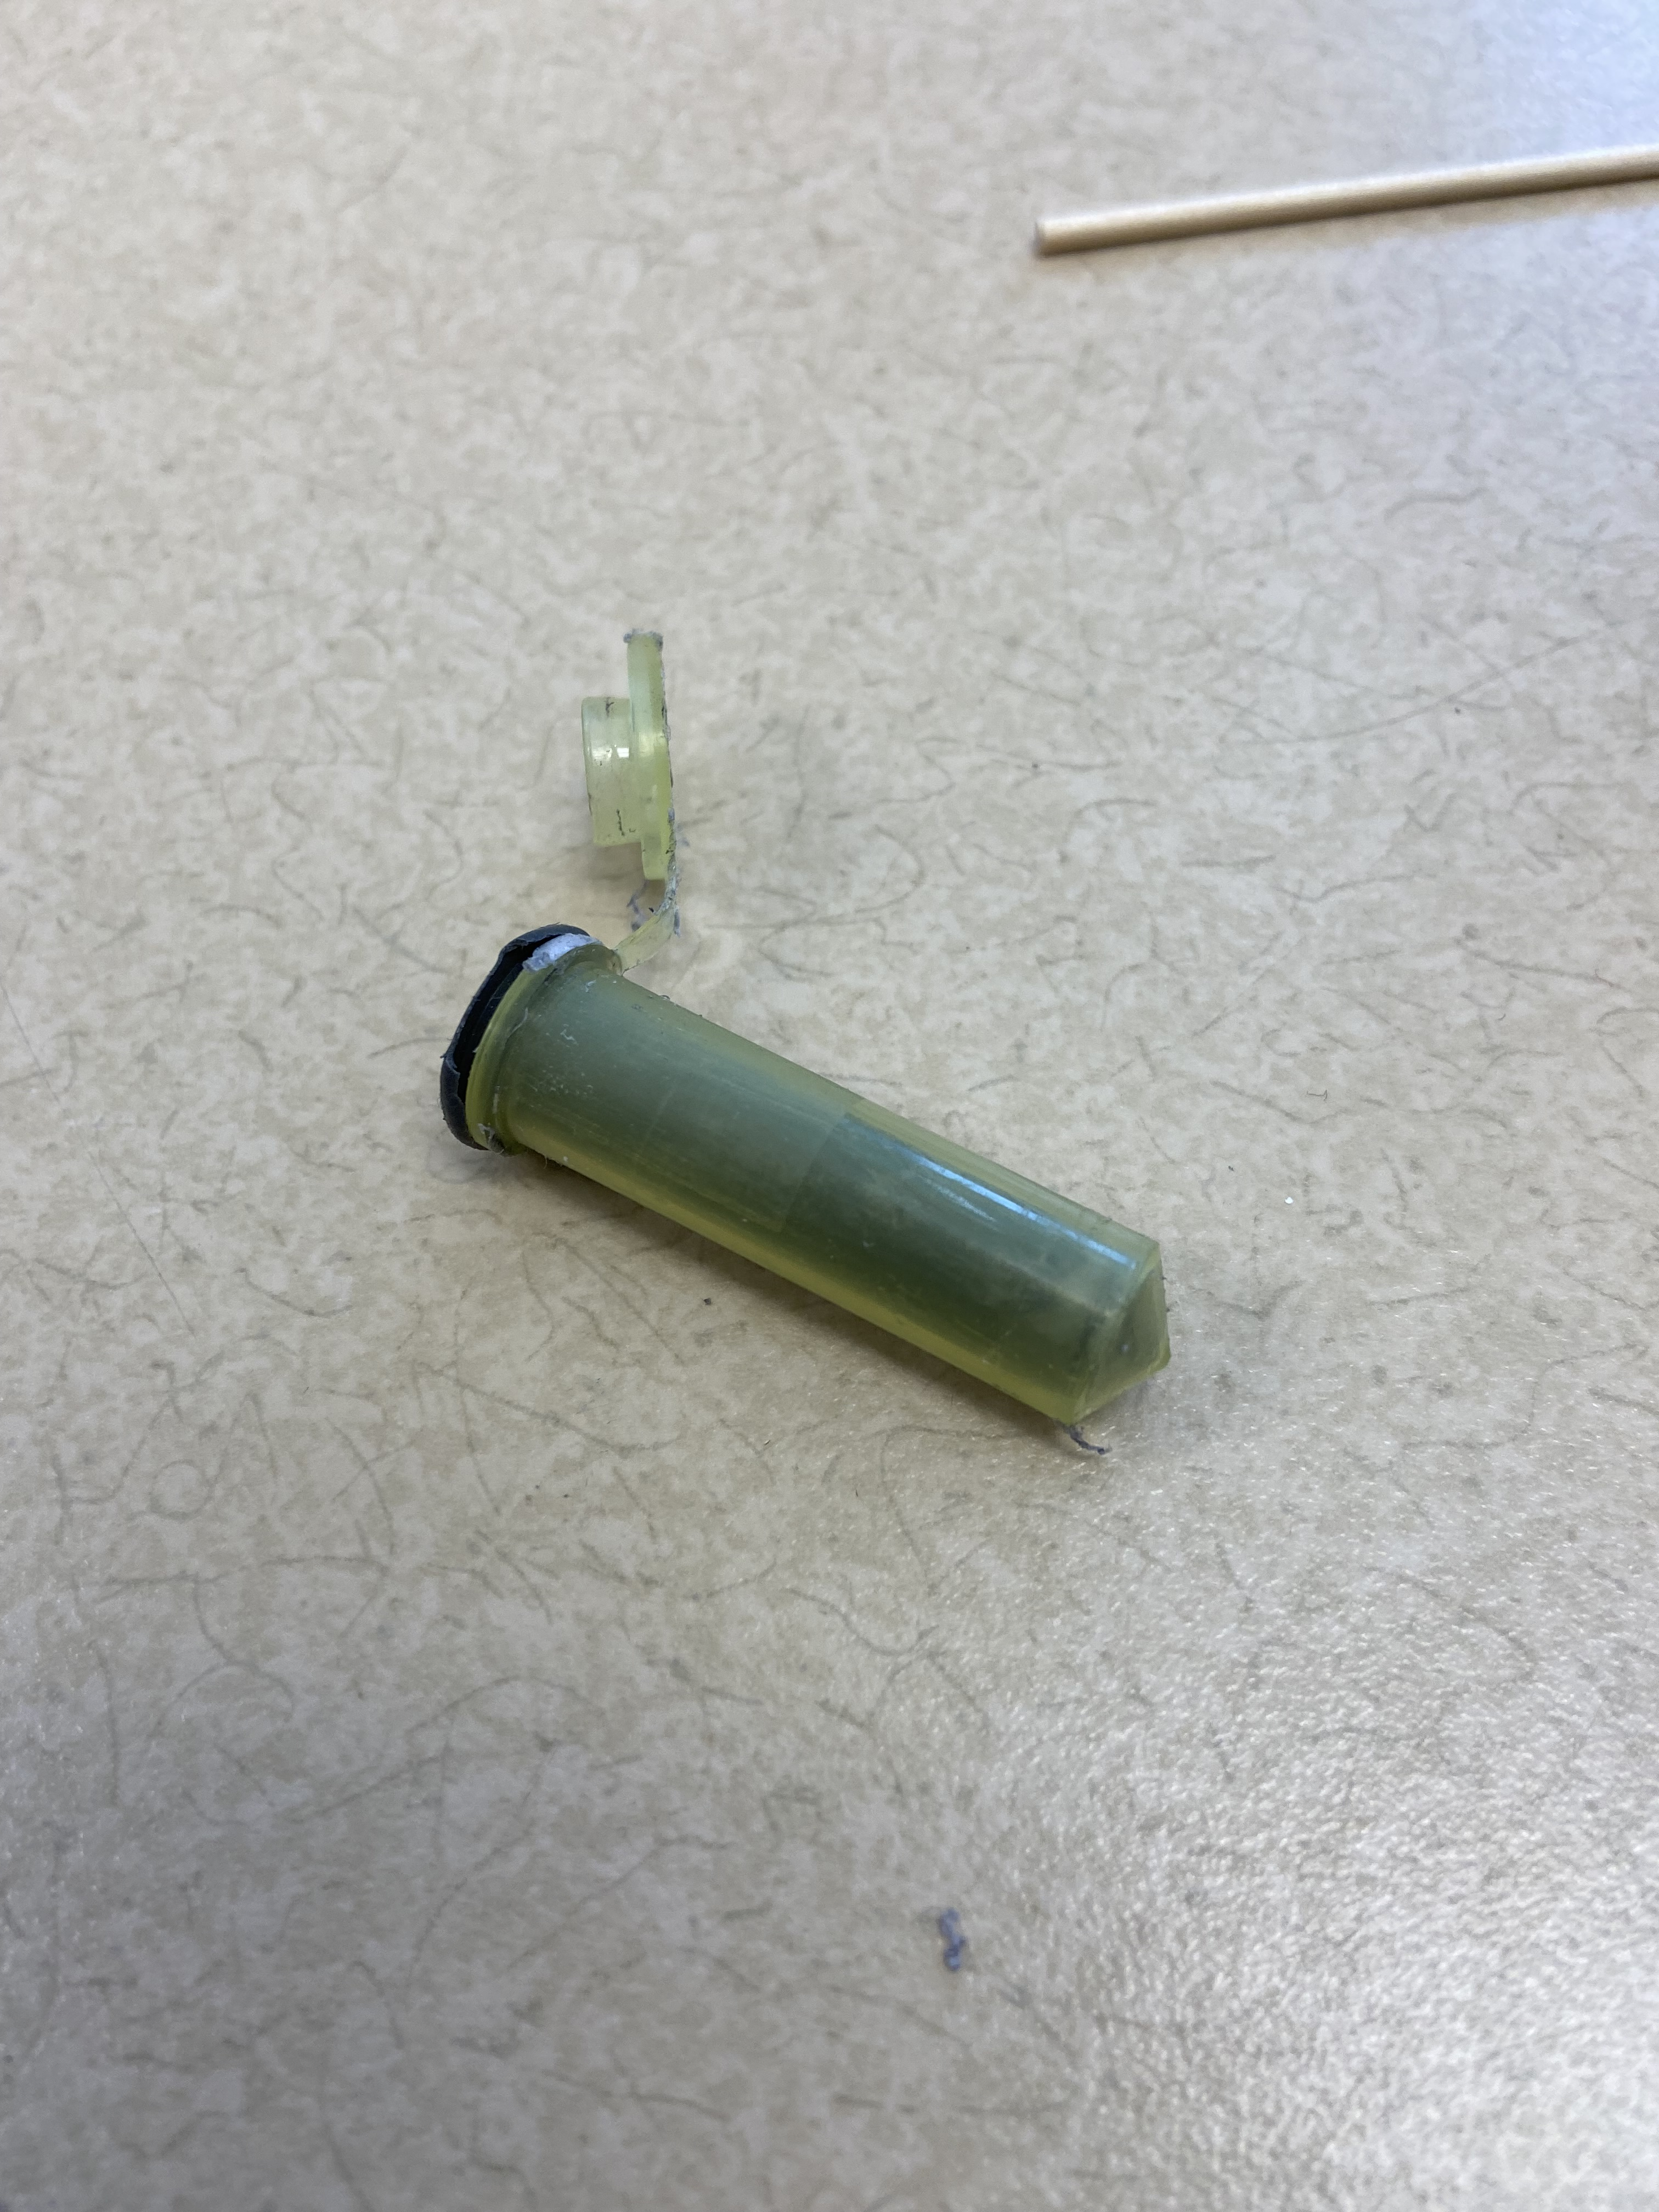
Approach
A silicon polymer matrix
Iron Particles
  44μm to 149μm diameter
  10% to 80% particle volume fraction
  and
MSMA Rod
  3 mm by 3mm by 20mm
  or
MSMA Particles
  30% volume fraction

Slide 5
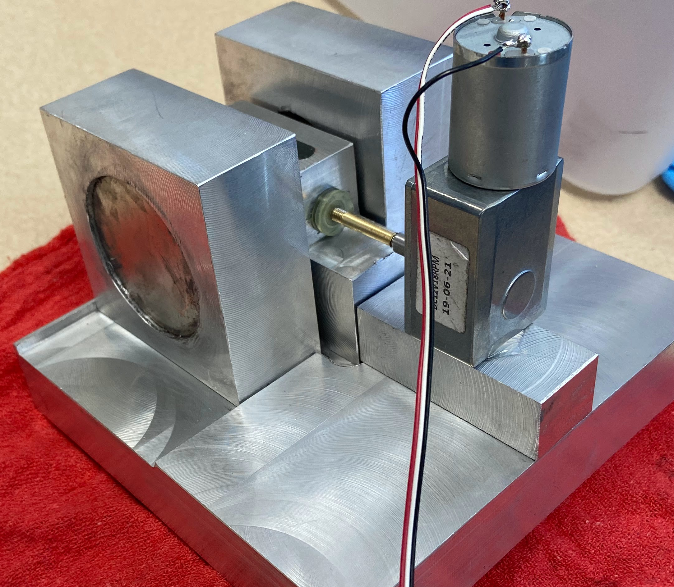
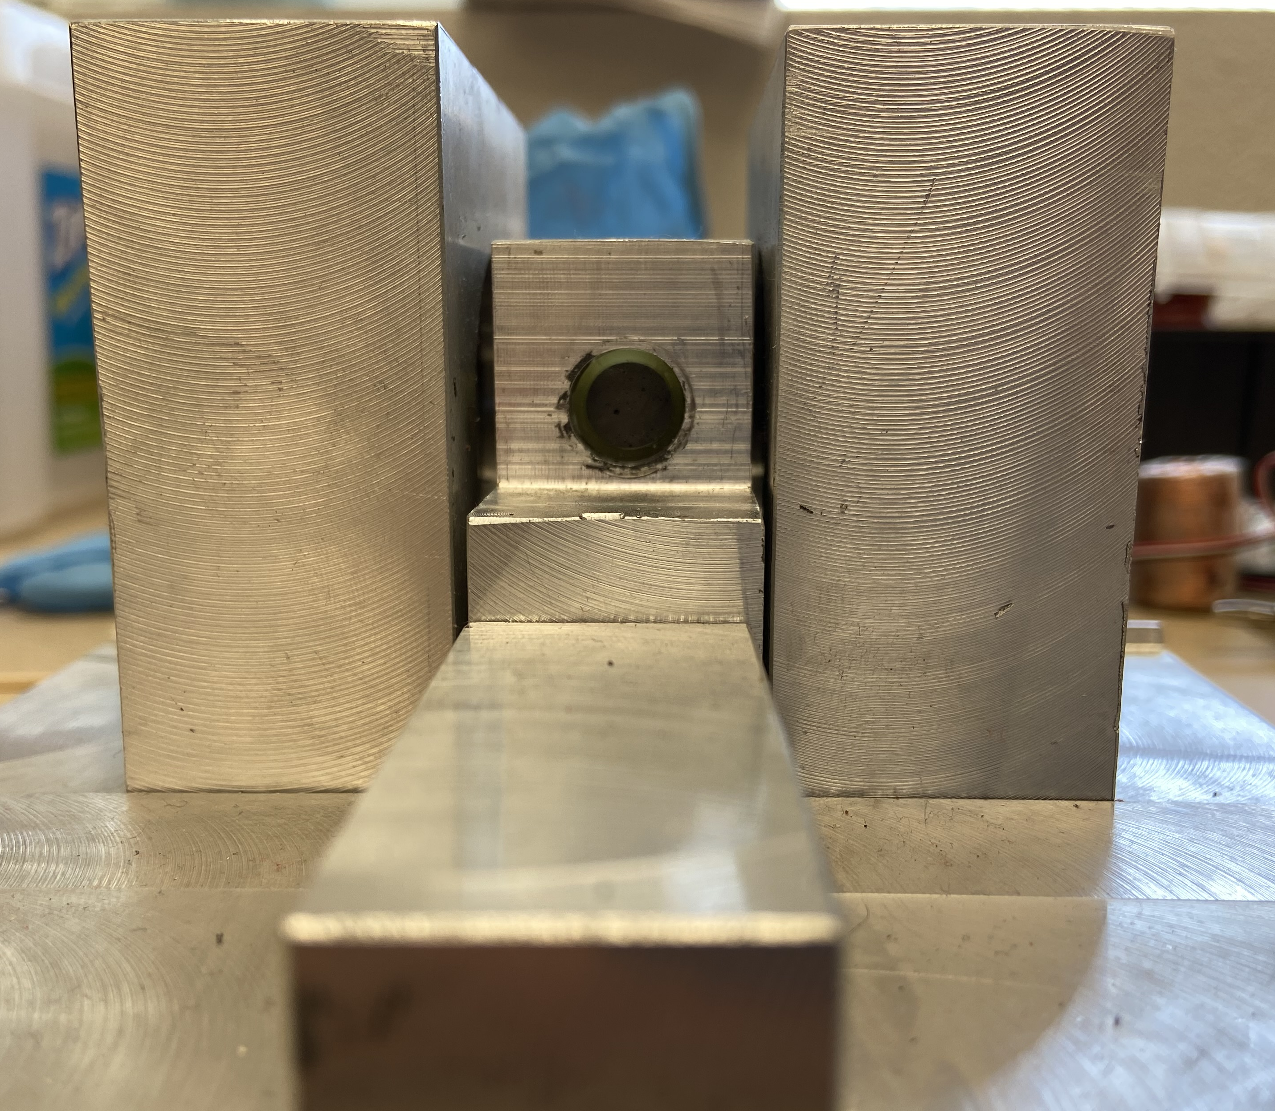
Samples Preparation
Spacer
Electric motor
Mold casting process
Samples with MSMA rods
  60% iron particles volume fraction mixed with
  a silicone polymer
  3 mm by 3mm by 20 mm MSMA rod added
  after silicone was poured in the mold
Samples made with MSMA Particles
  30% MSMA and 60% iron particles volume
  fractions mixed with a slime
  30% MSMA and 60% iron particles volume
  fractions mixed with a silicone polymer
  All samples were cured in a mold under rotating magnetic field
Gear box
Sample
Permanent magnet
Fabrication device
Permanent magnet
Spacer
Permanent magnet
Sample
Notes:
Gear box = speed reducer
Consistent and constant rotation during curing

Slide 6
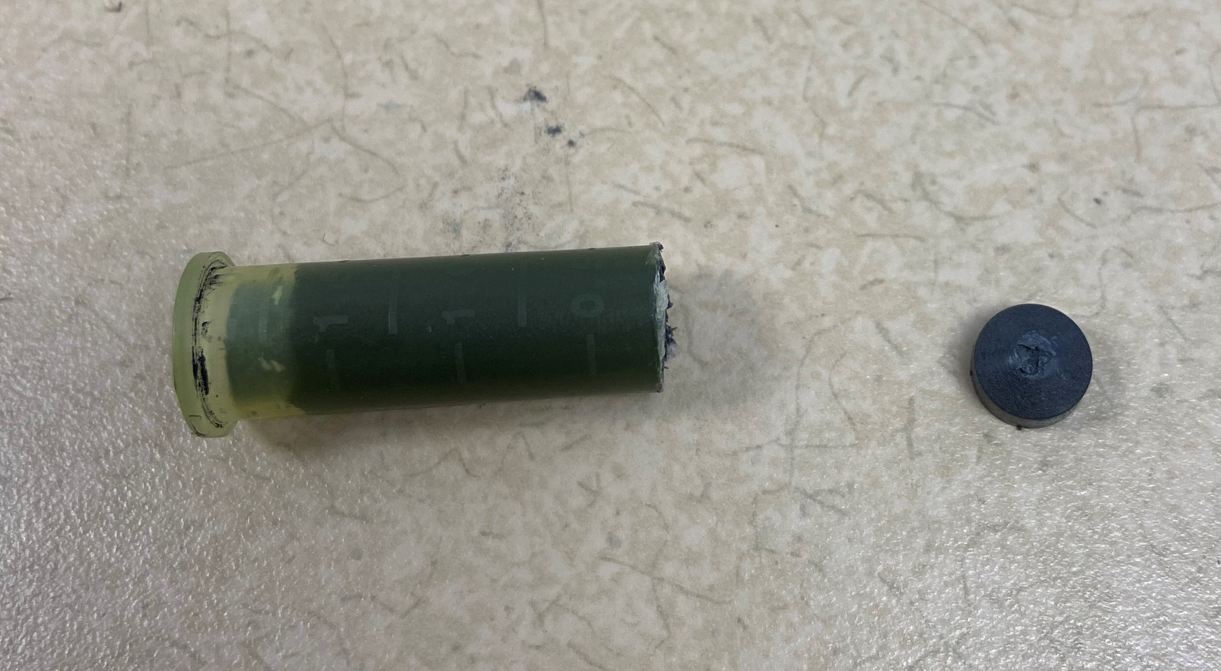
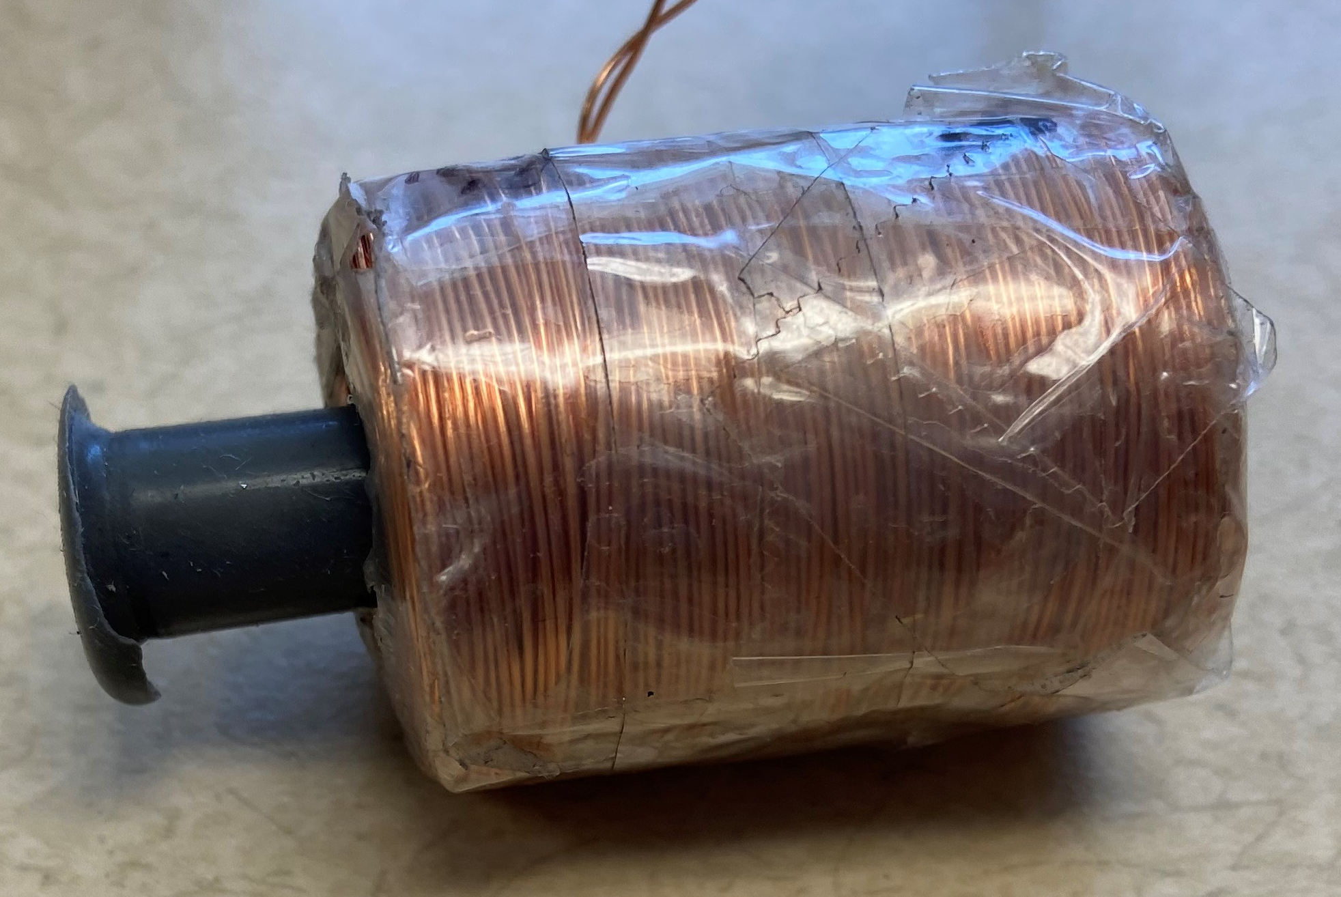
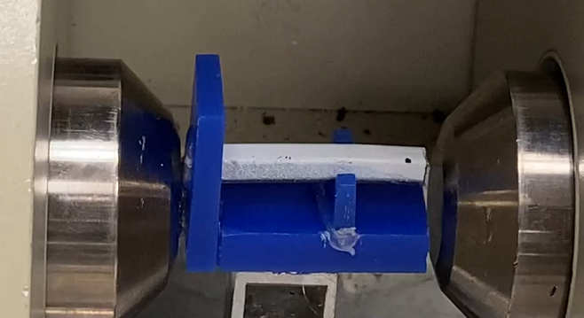
Samples Characterization
  The best MAC composition consists of 60% iron particles and a 3 mm by 3mm by 20 mm MSMA rod
  Evaluated the magnetic permeability of MAC samples (made with different iron particles volume fractions)
  Evaluated the compliance of the samples
  Evaluated the actuation strain of the samples
Magnetic Field
  Electromagnetic Coil
  Placed the MAC inside the coil
  Applied currents of up to 2.0A to the coil
  Measured magnetic field using a Gauss Meter
Strain
  Measured the actuation strain of the MAC
MAC sample
Coil
Electro-magnet
MAC sample

Slide 7
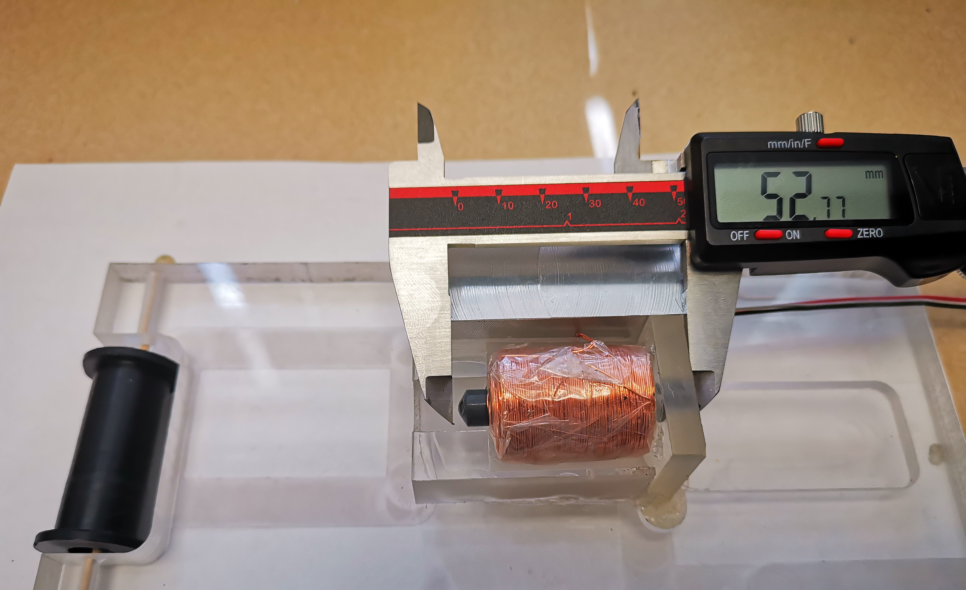
Results
  1.82% strain corresponding to a 0.96mm deformation when a 2.5A current was passed through the coil
  2.61% strain when an electromagnet generated a 0.42T field
0.96 mm

Slide 8
Conclusions
Project Goal:
  Design and manufacture a highly compliant MAC
Methods:
  Identified the composition that yields a highly magnetic permeable MAC
  Established the best MAC manufacturing procedure
  Characterized the MAC’s actuation performance
Adopted MAC Composition
  60% volume fraction iron particles, MSMA rod, and silicon matrix
  MAC performance
  1.86% strain corresponding to a 0.96mm axial deformation
  2.61% strain corresponding to a 0.42T magnetic field
Notes:
MAC actuates at lower currents with Iron

Slide 9
Future Work
Explore other matrix materials, including a more compliant magneto-elastic silicone made of iron nanoparticles suspended in polydimethylsiloxane.
Notes:
This magneto-elastic silicone was identified in the literature at the tail end of the project and has promising potential for our application.

Slide 10



Acknowledgements
Dr. Constantin Ciocanel, Ph.D, Mentor
Glen D’Silva, Ph.D Student
Paloma Davidson, NAU/NASA Space Grant Coordinator

Slide 11
Thank You

